Slide 1


Toheeb Olufade
06/10/2023

Slide 2

Outline
Executive Summary
Introduction
Methodology
Results
Conclusion
Appendix

Slide 3
(
Executive Summary
Overview
This project analyzed the success rate of SpaceX rocket launches at various launch sites.
The goal was to optimize the launch success rate and determine features and factors relevant to successful launch in order to bid against SpaceX.
Methodologies
Data Collection and Cleaning
Exploratory Data Analysis
Feature Engineering
Classification modelling
Hyperparameter tuning
Results
Best Performing Model : Decision Tree Algorithm with an accuracy score of 87.32% on the training data and 83.33% on the test data.
Optimal parameters for this model: {'criterion': 'gini', 'max_depth': 18, 'max_features': 'sqrt', 'min_samples_leaf': 1, 'min_samples_split': 2, 'splitter': 'best'}

Slide 4
Introduction
Background
Analysis of SpaceX rocket launches data.
Context
In recent years, space exploration has seen unprecedented growth with private companies like SpaceX leading the way. Understanding the factors influencing launch success is crucial for optimizing future missions.
Problems Addressed
Determining key factors influencing successful rocket launches.
Leveraging data to enhance launch planning and decision-making.
Enhancing reliability for payloads of varying weights.

Slide 5

Section 1

Slide 6
Methodology
Executive Summary
Data collection methodology:
Describe how data was collected
Perform data wrangling
Describe how data was processed
Perform exploratory data analysis (EDA) using visualization and SQL
Perform interactive visual analytics using Folium and Plotly Dash
Perform predictive analysis using classification models
How to build, tune, evaluate classification models

Slide 7
Data Collection
Data Sources
Obtained from official SpaceX records using SpaceX APIs.
Obtained from SpaceX Launches Wikipedia page.
Data Gathering Steps
Obtained SpaceX launch records from official sources and Wikipedia.
Integrated additional mission details from SpaceX datasets.
Ensured accuracy and consistency through rigorous validation and cleaning processes.
Data Collection Flowchart
Accessing Official Sources
Integration with SpaceX Databases
Data Validation and Cleaning

Slide 8
Data Collection – SpaceX API
Executed RESTful queries to SpaceX API for real-time launch data.
Converted raw API responses into structured datasets.
Merged the SpaceX records for comprehensive insights.
Scrutinized and rectified anomalies for high-quality, reliable data.
GitHub URL
https://github.com/ToheebA/Rocket-Launch-Project/blob/main/jupyter-labs-spacex-data-collection-api.ipynb
Requested and parsed the SpaceX launch data using the GET request
Filtered the dataframe to only include launches
Dealt with missing values

Slide 9
Data Collection - Scraping
Utilized Python libraries like BeautifulSoup to parse HTML structure from Wikipedia page.
Extracted launch information including date, mission, and outcomes.
Processed raw HTML data into structured datasets.
GitHub URL
https://github.com/ToheebA/Rocket-Launch-Project/blob/main/jupyter-labs-webscraping.ipynb
Requested the Falcon9 Launch Wiki page from its URL
Extracted all column/variable names from the HTML table header
Created a data frame by parsing the launch HTML tables

Slide 10
Data Wrangling
Data Cleaning: - Addressed missing values, duplicates, and outliers to ensure data quality.
Standardization:
- Uniformly formatted data for consistency in analysis
Normalization:
Categorical Encoding:
- Converted categorical variables into numerical format for modeling.
Feature Engineering:
- Created new features to enhance predictive capabilities.
GitHub URL
https://github.com/ToheebA/Rocket-Launch-Project/blob/main/labs-jupyter-spacex-data_wrangling_jupyterlite.jupyterlite.ipynb
Data
Wrangling
Flowchart
Calculate the number and occurence of mission outcome per orbit type
Create a landing outcome label from Outcome column
Calculate the number of launches on each site
Calculate the number and occurrence of each orbit

Slide 11
EDA with Data Visualization
The following charts were created:
Scatterplot of FlightNumber vs PayloadMass
Scatterplot of FlightNumber vs LaunchSite
Scatterplot of PayloadMass vs LaunchSite
Barchart of Orbit types with their respective Success rate
Scatterplot of FlightNumber vs Orbit
Scatterplot of PayloadMass vs Orbit
Line chart of Year vs Average Success Rate
GitHub URL
https://github.com/ToheebA/Rocket-Launch-Project/blob/main/jupyter-labs-eda-dataviz.ipynb.jupyterlite.ipynb

Slide 12
EDA with SQL
The following SQL queries were made:
Query to display the names of the unique launch sites in the space mission.
Query to display 5 records where launch sites begin with the string ‘CCA’
Query to display the total payload mass carried by boosters launched by NASA(CRS).
Query to display average payload mass carried by booster version F9 v1.1
Query to list the date when the first successful landing outcome in ground pad was achieved
Query to list the names of the boosters which have success in drone ship and have payload mass greater than 4000 but less than 6000
GitHub URL
https://github.com/ToheebA/Rocket-Launch-Project/blob/main/jupyter-labs-eda-sql-coursera_sqllite.ipynb

Slide 13
Build an Interactive Map with Folium
The following map objects were added:
Markers: Represented launch sites and coastline points.
Circles: Highlighted specific areas for visual emphasis.
Lines: Illustrated paths or boundaries for better spatial understanding.
Reasons for adding map objects:
Markers: Provided visual reference points for launch sites and coastline, enhancing map interactivity and clarity.
Circles: Emphasized specific regions, such as launch sites, for important context.
Lines: Outlined boundaries or paths to improve spatial comprehension, e.g., equator line
GitHub URL
https://github.com/ToheebA/Rocket-Launch-Project/blob/main/lab_jupyter_launch_site_location.jupyterlite%20(1).ipynb

Slide 14
Build a Dashboard with Plotly Dash
The following plots/graphs and interactions were added to the dashboard:
Pie Chart: Displayed success rates for different launch sites.
Scatter Chart: Showed the correlation between payload and launch success.
Dropdown: Allowed users to select specific launch sites for detailed information.
Range Slider: Enabled users to filter data based on payload range.
Reasons for adding elements:
Pie Chart: Provided a quick overview of success rates, aiding in site comparison.
Scatter Chart: Offered insights into the relationship between payload and success, aiding in decision-making.
Dropdown: Facilitated site-specific exploration for deeper understanding.
Range Slider: Empowered users to customize data view based on payload criteria.
GitHub URL
https://github.com/ToheebA/Rocket-Launch-Project/blob/main/spacex_dash_app.py

Slide 15
Predictive Analysis (Classification)
Data Preprocessing & Model Selection
Model Development Process
Data Preprocessing:
Handled missing values and categorical variables.
Applied feature scaling.
Model Selection:
Explored Logistic Regression, SVM, Decision Trees, and K-Nearest Neighbor
Initial Evaluation:
Assessed models with default parameters using cross-validation
Hyperparameter Tuning:
Conducted GridSearchCV to find optimal parameters.
Final Model Selection:
Decision Trees exhibited highest performance
GitHub URL
https://github.com/ToheebA/Rocket-Launch-Project/blob/main/labs_module_4_SpaceX_Machine_Learning_Prediction_Part_5.jupyterlite.ipynb
Initial Evaluation & Hyperparameter Tuning
Final Model Selection

Slide 16
Results
Exploratory Data Analysis Results:
Summary statistics.
Distribution of launch outcomes.
Correlation between key variables.
Interactive Analysis:
User-friendly interface.
Dynamic filters for site selection.
Real-time data updates.
Predictive Analysis Results
Classification model performance.
Success rate predictions.
Model evaluation metrics.

Slide 17

Section 2

Slide 18
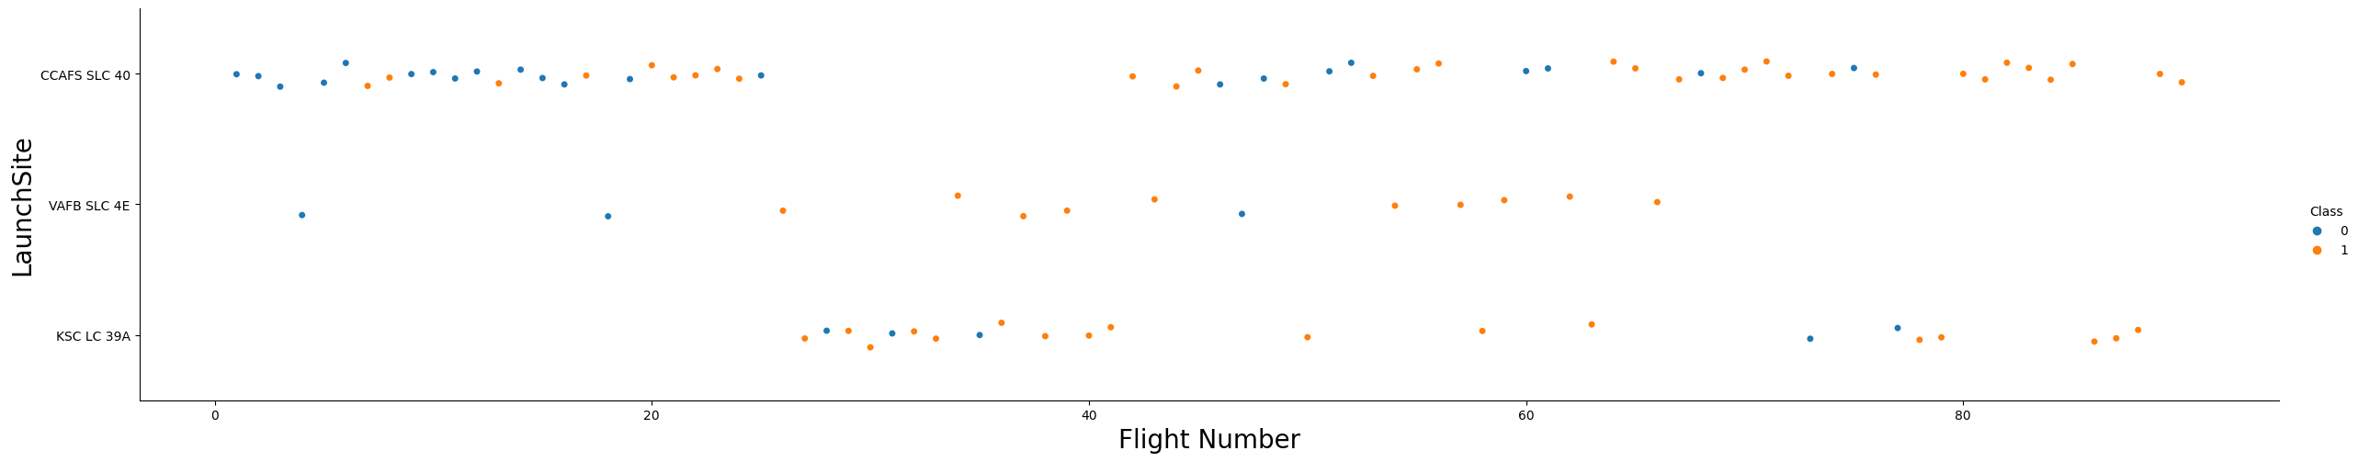
Flight Number vs. Launch Site
It is observed from the plot that site KSC LC 39A did not have an any falcon 9 launch until around flight number 23.
Site CCAFS SLC 40 has the highest number of falcon 9 launches and highest number of unsuccessful launches.
Site VAFB SLC 4E has just three unsuccessful falcon 9 launches.

Slide 19
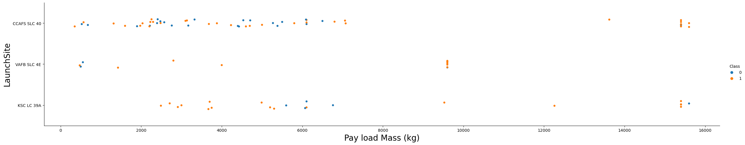
Payload vs. Launch Site
It is observed from the plot that site CCAFS SLC 40 did not have falcon 9 launches with payload mass between 7000kg and 13000kg.
Site VAFB SLC 4E did not have falcon 9 launches with payload mass greater than 10000kg.
Site KSC LC 39A did not have falcon 9 launches with payload mass lesser than 2000kg.

Slide 20
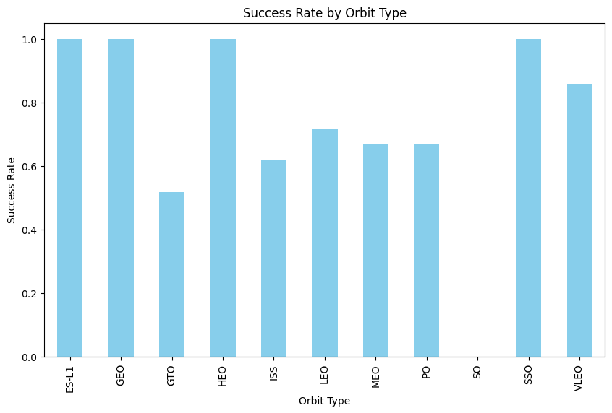
Success Rate vs. Orbit Type
It is observed that ES-L1, GEO, HEO and SSO orbits have the highest success rate of 100%.
GTO orbit has the lowest success rate of 50%.

Slide 21
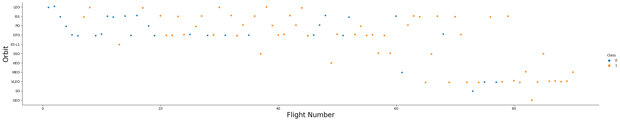
Flight Number vs. Orbit Type
It is observed that the success of LEO orbit appears related to the number of flights while on the other hand, there seems to be no relationship between flight number when in GTO orbit.
It is observed that GEO, SO, VLEO, and MEO orbits did not have falcon 9 launches until around flight number 60.

Slide 22
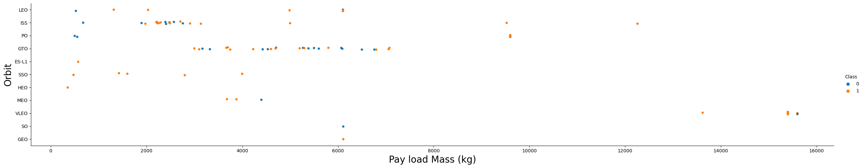
Payload vs. Orbit Type
The scatter plot shows that heavy payload increases the chances of successful landing or positive landing rate for Polar, LEO and ISS.
However it is undistinguishable for GTO as both positive landing rate and negative landing(unsuccessful mission) are both here.

Slide 23
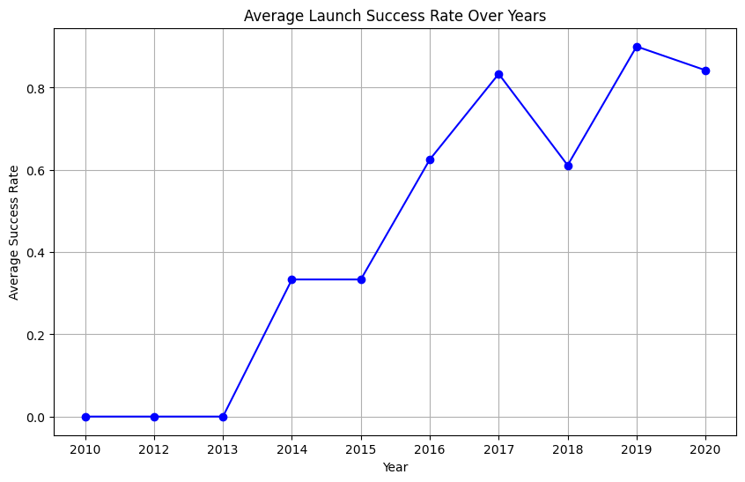
Launch Success Yearly Trend
The average success rate kept increasing from 2013 until 2020 with a single drop in 2018.

Slide 24
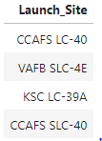
All Launch Site Names
There are four unique launch sites:
CCAFS LC-40
VAFB SLC-4E
KSC LC-39A
CCAFS SLC-40

Slide 25
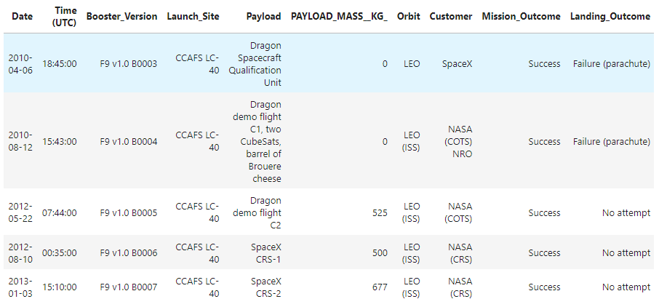
Launch Site Names Begin with 'CCA'

Slide 26
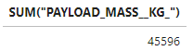
Total Payload Mass
The total payload mass carried by boosters launched by NASA (CRS) is 45596kg.

Slide 27
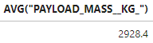
Average Payload Mass by F9 v1.1
The average payload mass carried by booster version F9 v1.1 is 2928.4kg.

Slide 28
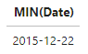
First Successful Ground Landing Date
The date for the first successful landing outcome in ground pad is 2015-12-22.

Slide 29
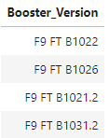
Successful Drone Ship Landing with Payload between 4000 and 6000
The figure above shows the names of boosters that have success in drone ship and have payload mass greater than 4000 but less than 6000.

Slide 30
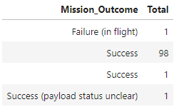
Total Number of Successful and Failure Mission Outcomes
The table above shows the total number of successful and failure mission outcomes.

Slide 31
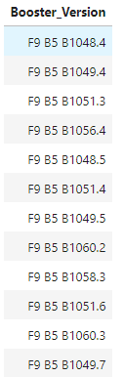
Boosters Carried Maximum Payload
The table shows 12 distinct booster versions that carried the maximum payload mass.

Slide 32
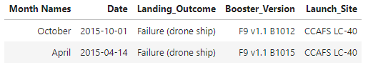
2015 Launch Records
The query shows two records for the months in 2015.

Slide 33
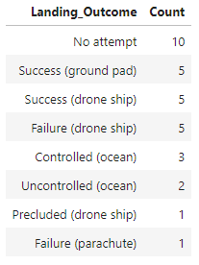
Rank Landing Outcomes Between 2010-06-04 and 2017-03-20
The table above shows no attempt landing outcome has the highest count of 10 while failure (parachute) landing outcome has the lowest count of 1.

Slide 34

Section 3

Slide 35
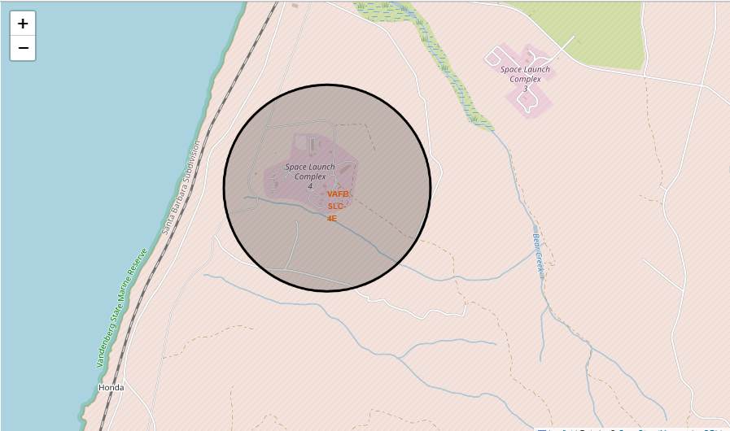
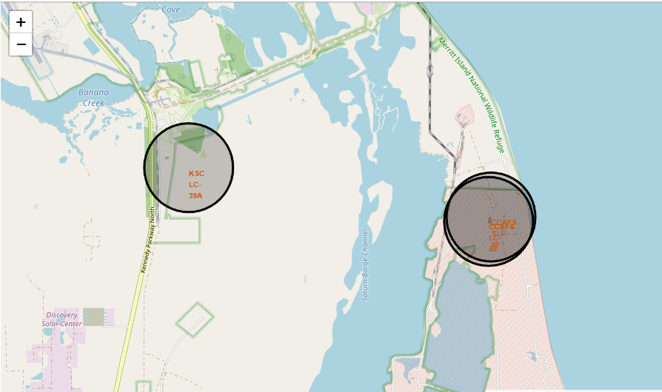
Folium Map Showing the four Launch Site Locations
The screenshot displays four launch sites (CCAFS LC-40, CCAFS SLC-40, KSC LC-39A, and VAFB SLC-4E) on a Folium map, showing their precise geographical coordinates and potential proximity to significant landmarks or bodies of water.

Slide 36
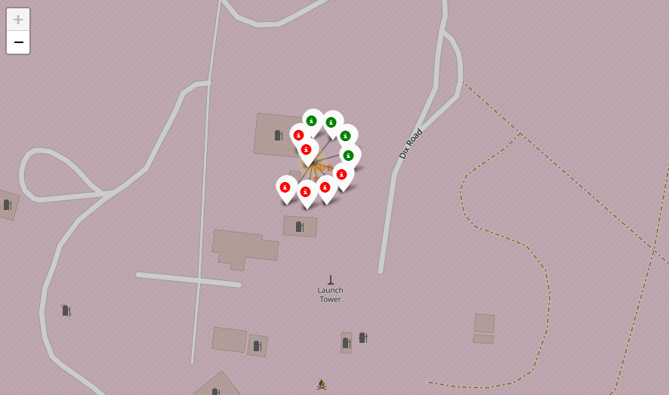
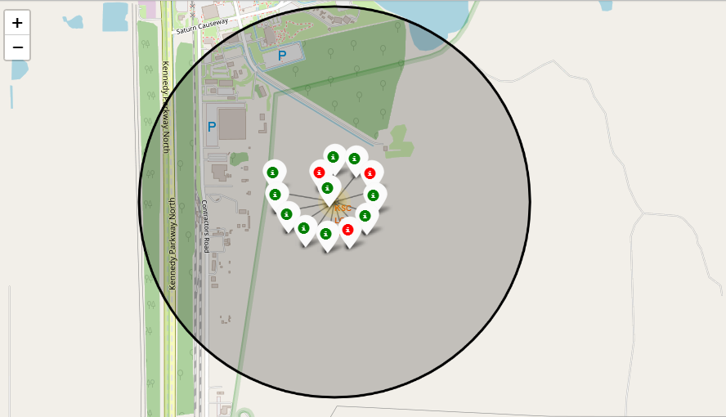
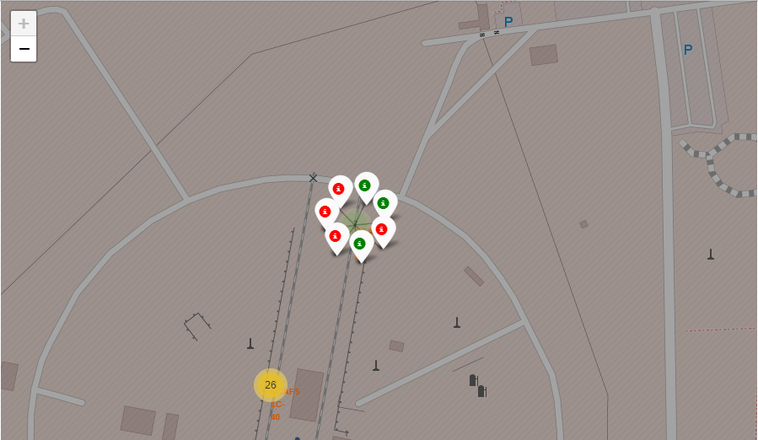
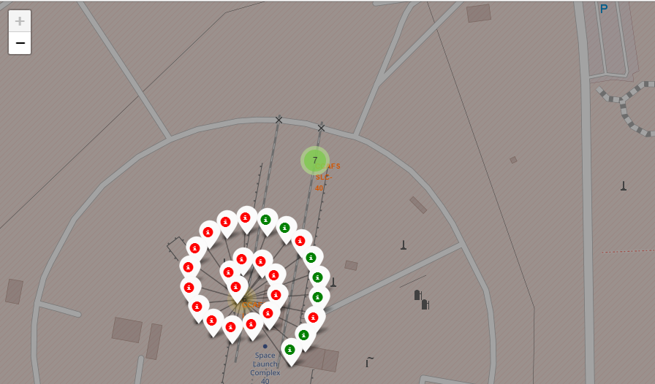
Folium Map Showing the Launch Outcomes
The color-coded markers on the Folium map distinguish between successful (green) and failed (red) launch outcomes, offering a visual overview of success rates at different launch sites.

Slide 37
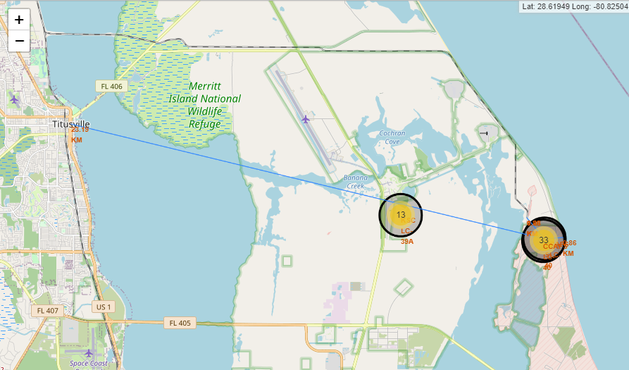
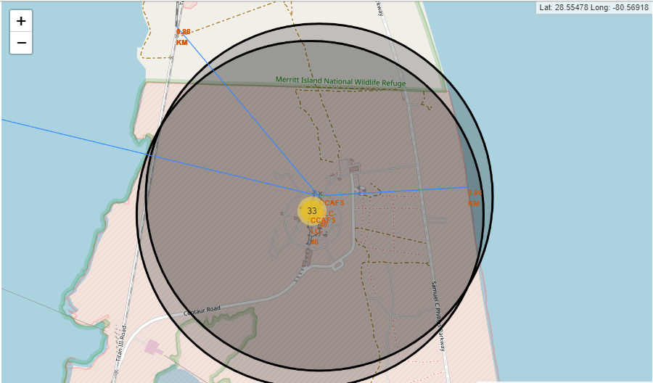
Folium Map Showing the Proximities of a Launch Site to Certain Landmarks
The Folium map offers a visual overview of a launch site's distance to significant landmarks. The labelled markers indicate the proximity to the coastline, nearest city, and nearest railway, providing valuable insights for launch logistics and safety evaluations. It is also observed that the launch sites are situated at considerable distances from cities and towns for safety reasons.

Slide 38

Section 4

Slide 39
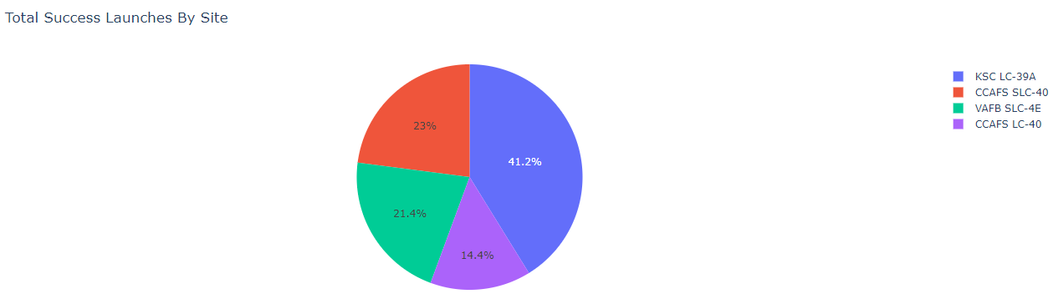
Dashboard Screenshot showing Total Success Launches by Site
The pie chart displayed in the Dash app provides a visual representation of launch success counts for all sites. It effectively conveys the distribution of successful and failed launches across different launch sites. This information is essential for evaluating the overall performance of each site and making informed decisions about future launches.

Slide 40
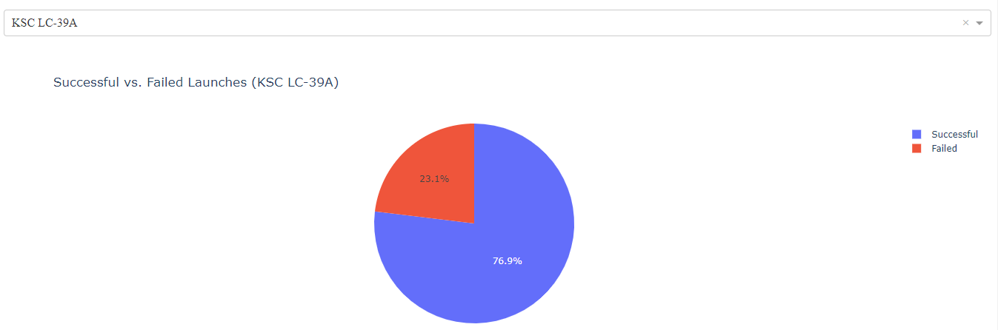
Dashboard Screenshot showing Success Rate for the most Successful Site
The pie chart displayed in the Dash app highlights the launch success ratio for the specific site with the highest success rate. It offers a clear visual representation of the proportion of successful and failed launches at this site.

Slide 41
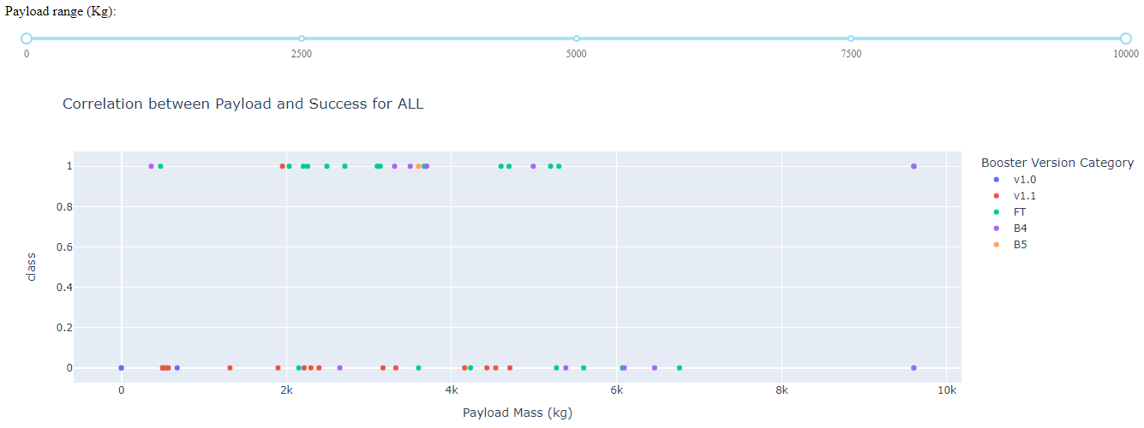
Dashboard Screenshot Showing the Correlation between various Payloads and Success Rates for all Sites
The scatter plot depicts the relationship between payload mass and launch outcomes, offering insights into the influence of payload on launch success rates. The range slider allows users to refine payload selections for a more focused analysis.

Slide 42

Section 5

Slide 43
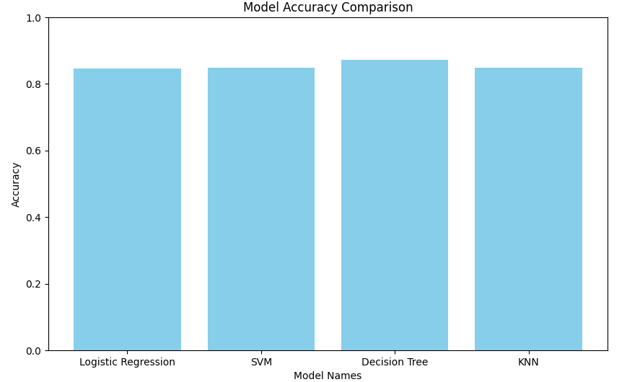
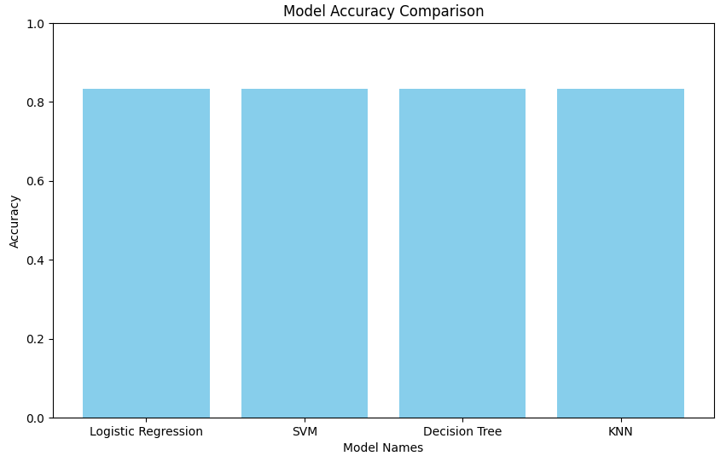
Classification Accuracy
Decision Tree model has the highest classification accuracy on the train data as shown in the figure on the left while the four models have the same accuracy on the test data as shown in the figure on the right.

Slide 44
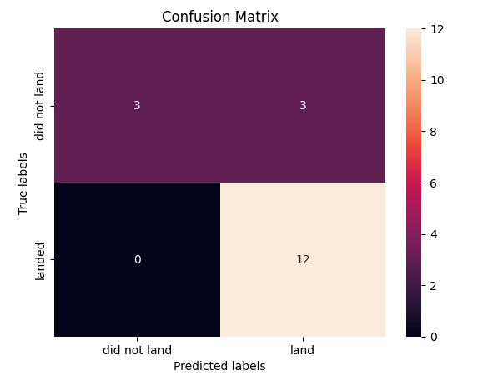
Confusion Matrix
The confusion matrix indicates that the model is performing well in predicting successful rocket landings, with no instances of false negatives. However, it does have some false positives, meaning it occasionally predicts a successful landing when it doesn't occur. Overall, it is a reliable model for predicting successful landings.

Slide 45
Conclusions
Rich Data, In-Depth Insights: Leveraged comprehensive SpaceX data to gain profound insights into launch outcomes, site locations, and key factors influencing success.
Effective Data Preparation: Meticulously cleaned and prepared the dataset, ensuring high data quality for meaningful analysis.
Dynamic Visualizations: Utilized interactive maps and insightful plots to visually represent launch site locations, success rates, and payload correlations, enhancing data understanding.
Accurate Predictive Model: Developed a high-performing classification model, demonstrating the power of data-driven decision-making in space rocket launches.
Strategic Insights for Future Missions: The analysis provides valuable information for SpaceX, aiding in strategic planning and decision-making for upcoming missions.

Slide 46
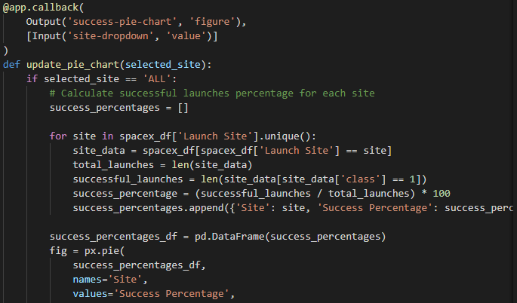
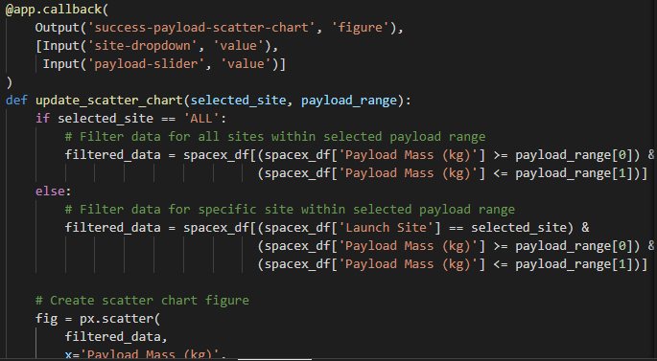
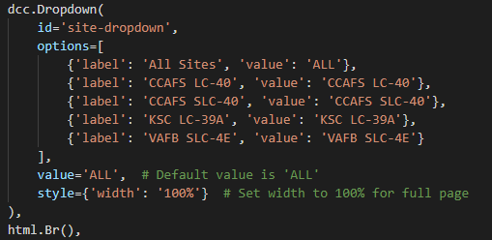
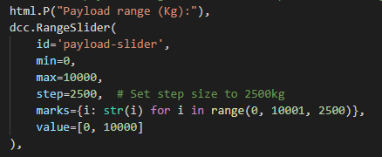
Appendix
%sql SELECT DISTINCT "Launch_Site" FROM SPACEXTABLE;
%sql SELECT * FROM SPACEXTABLE WHERE Launch_Site LIKE 'CCA%' LIMIT 5;
%sql SELECT SUM("PAYLOAD_MASS__KG_") FROM SPACEXTABLE WHERE "Customer" = 'NASA (CRS)’;
%sql SELECT AVG("PAYLOAD_MASS__KG_") FROM SPACEXTABLE WHERE "Booster_Version" = 'F9 v1.1’;
%sql SELECT MIN(Date) FROM SPACEXTABLE WHERE "Landing_Outcome" = 'Success (ground pad)’;

Slide 47
Appendix
%sql SELECT DISTINCT Booster_Version FROM SPACEXTABLE WHERE "Landing_Outcome" = 'Success (drone ship)' AND "PAYLOAD_MASS__KG_" BETWEEN 4000 AND 6000;
%sql SELECT "Mission_Outcome", COUNT(*) as "Total" FROM SPACEXTABLE GROUP BY "Mission_Outcome";
%sql SELECT DISTINCT "Booster_Version" FROM SPACEXTABLE WHERE "PAYLOAD_MASS__KG_" = (SELECT MAX("PAYLOAD_MASS__KG_") FROM SPACEXTABLE);
%%sql
SELECT
CASE
WHEN substr(Date, 6, 2) = '01' THEN 'January'
WHEN substr(Date, 6, 2) = '02' THEN 'February'
WHEN substr(Date, 6, 2) = '03' THEN 'March'
WHEN substr(Date, 6, 2) = '04' THEN 'April'
WHEN substr(Date, 6, 2) = '05' THEN 'May'
WHEN substr(Date, 6, 2) = '06' THEN 'June'
WHEN substr(Date, 6, 2) = '07' THEN 'July'
WHEN substr(Date, 6, 2) = '08' THEN 'August'
WHEN substr(Date, 6, 2) = '09' THEN 'September'
WHEN substr(Date, 6, 2) = '10' THEN 'October'
WHEN substr(Date, 6, 2) = '11' THEN 'November'
WHEN substr(Date, 6, 2) = '12' THEN 'December'
END AS "Month Names",
"Date",
"Landing_Outcome",
"Booster_Version",
"Launch_Site"
FROM SPACEXTABLE
WHERE substr(Date, 1, 4) = '2015' AND "Landing_Outcome" = 'Failure (drone ship)';

Slide 48


